Slide 1
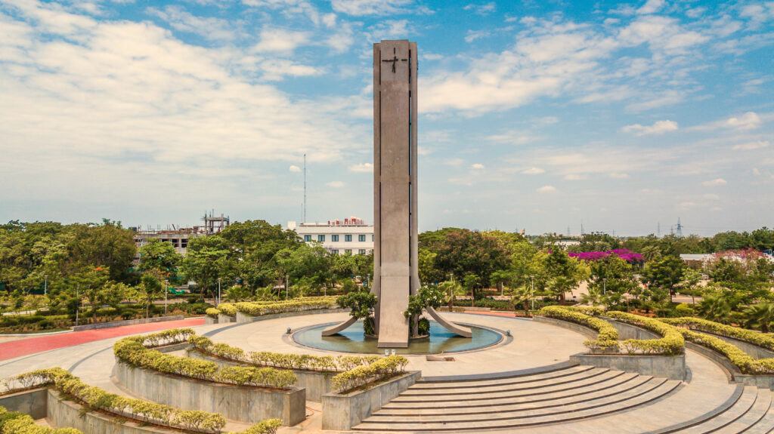
Team Members : 21.Danush G 22.Debika 23.Deepak J 24.Deepak Kumar
SSN Clubs Management

Slide 2
PROBLEM STATEMENT
Our college has various clubs that conducts so many events. Very often the efforts to create and coordinate such events goes unnoticed. Starting from scheduling, poster designing, content writing, posting and publishing event details across all platforms, connecting with guest, looking for sponsors , planning on who can host event, arranging refreshments, preparing materials and so on. All of this when had to be distributed among club members and tracking the progress of work can be really tedious. And from student member side, if part of more than one club, it might be confusing on which one has to be given priority .

Slide 3
CLIENT INFORMATION
The club heads, event management team members are our client
we personally talked with:
Megnathan Vijaykumar- AIT vice president
Kilwish Nighjo- Lakshya head
A Shafiya Siddharth- LOP crew head
The stakeholders are all students
club members - follow up tasks
freshers - clubs information

Slide 4
REQUIREMENTS
A registration page for all students
login credential for club members and heads
college email id and password to be stored along with roll no
know about list of clubs
members request to club heads and authority to club heads to remove members from team
Plan an upcoming event
schedule
allot task to student members
follow up
add comments about work done

Slide 5
DATA REQUIREMENTS
The following data are expected to be given by user
name
roll number
department
year
email(college mail id)
role in the club specified

Slide 6
PROBLEM SCOPE
The project when deployed provides easy access to club members and the heads to organize the events exclusively for SSNites. It will reduce the workload for the heads and members too

Slide 7
QUICK OVERVIEW
Our project manages various club activities, the primary features include :
Event Management
Assigning Tasks
Adding comments on the work-done

Slide 8
CLIENT REQUIREMENTS
Sign up for club heads and club members.
Club heads can create a club, schedule an event, assign tasks, fix a deadline, follow progress of tasks assigned i.e. to be able to plan and execute events altogether.
Club heads can create polls(asking for opinions about data & time for events), meets(online & offline), write emails to teachers(for audi permission).
Club members can raise issues, request for deadline extension, look up for task assigned for them.

Slide 9
MODEL USED
AGILE MODEL :
The meaning of agile is swift or versatile. Agile process model refers to a software development approach based on iterative development. Agile methods break tasks into smaller iterations, or parts do not involve long term planning. The project scope and requirements are laid down at the beginning of the development process. Plans regarding the number of iterations, the duration and the scope of each iteration are clearly defined in advance.

Slide 10
USER STORIES
Sprit | Epic | User Story | Requirement/ User Story | Essential/ Desirable | Description of the requirement | Remarks
1 | Sign-up | 1 | Display sign-up page. | Essential | New users are required to sign up with their mail id, password and role. | For both members and club heads.
 | Sign-in | 2 | Displays sign-in page. | Essential | Registered users can login using mail id and password. | For both members and club heads.

Slide 11
Sprit | Epic | User Story | Requirement/ User Story | Essential/ Desirable | Description of the requirement | Remarks
2 | Create team | 3 | The team appears in the dashboard. | Essential | Users can create team by entering name, description of the club. | Only for club heads.
 | Invite link generated | 4 | Once team is created, link is generated. | Essential | Generated link can be circulated to members and club heads can also add members. | For both members and club heads.
 | Joining the team | 5 | Allowing members to join teams. | Essential | Members can login/ sign up and then join respective teams. | For club members.

Slide 12
Sprit | Epic | User Story | Requirement/ User Story | Essential/ Desirable | Description of the requirement | Remarks
RS2 | Team member | 6 | Members should be allowed to be part of more than one team. | Essential | One person can be part of more than one team. | For club members.
 | Remove members | 7 | Team members can be removed. | Essential | Club heads can remove their respective team members. | For club heads.

Slide 13
Sprit | Epic | User Story | Requirement/ User Story | Essential/ Desirable | Description of the requirement | Remarks
3 | Event scheduling | 8 | Club heads can now schedule events. | Essential | They are required to enter name, date, time and location of the event. | Only for club heads.
 | Assigning tasks to club members | 9 | Each club member must be assigned a task. | Essential | Club heads can assign tasks to club members and set deadlines for the same. | Only for club heads.
 | Notifications | 10 | Notifying users. | Essential | Members are notified in their dashboard about the pending tasks | For club members.

Slide 14
Sprit | Epic | User Story | Requirement/ User Story | Essential/ Desirable | Description of the requirement | Remarks
RS4 | Reviewing | 11 | Club heads should be able to review the tasks. | Essential | Club heads can now analyze the completed tasks. | For club heads.
 | Poll | 12 | Club heads can create polls to know the desirable schedule. | Essential | To know of the convenient time of the event, this can be done. | For club heads.

Slide 15
RISK INVOLVED
Club head not notified about request- when student has requested but club head hasn’t noticed
Redundancy in database- if a user signs up with emails apart from college, same user details are stored twice - ensuring the students use only their college mail id would help
Failure in configuring of database - the database may not be properly configured- losing information or having incorrect details
Comments not displayed - the description may not be received by students
Not able to submit before deadline , no update from team member side - 10- can cause undue delay in work- again, notifying few hours before deadline once again before deadline could help

Slide 16
DEVELOPMENT
FRONTEND :
HTML
CSS
BACKEND :
Mongo DB
Django

Slide 17
OUTPUT (screenshots)…

Slide 18
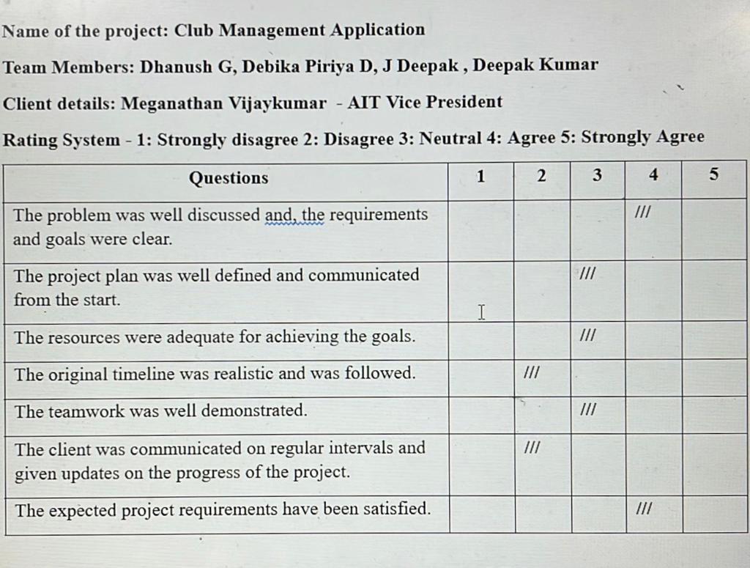

Slide 19
OVERALL CLIENT RESPONSE
The overall client response was quiet satisfying, we asked them few questions on the overall project presentation and they rated us accordingly. On a average they rated us about 3-3.5. They were happy on how well our project was put over and easy to use.

Slide 20
THANK YOU

